Slide 1
Art Supply
By: Leah Walker, Sarah Lee

Slide 2
Project Overview
Organize, compare, and contrast different art supplies
The goal of this database is to give the user organized information on specified art products.
After the user specifies which are product(s) they want to view, the program will then pull up:
Price
Rating
Type
Supply (Available Quantity)

Slide 3
Main Use-Case
Main use-case:
The user will be able to input or delete the products obtained from the supplier into the database and create a viewable list with details.
The database will be able to recognize that the user wants all of the information stored relating to the input given and display the information based on the order of priority.

Slide 4
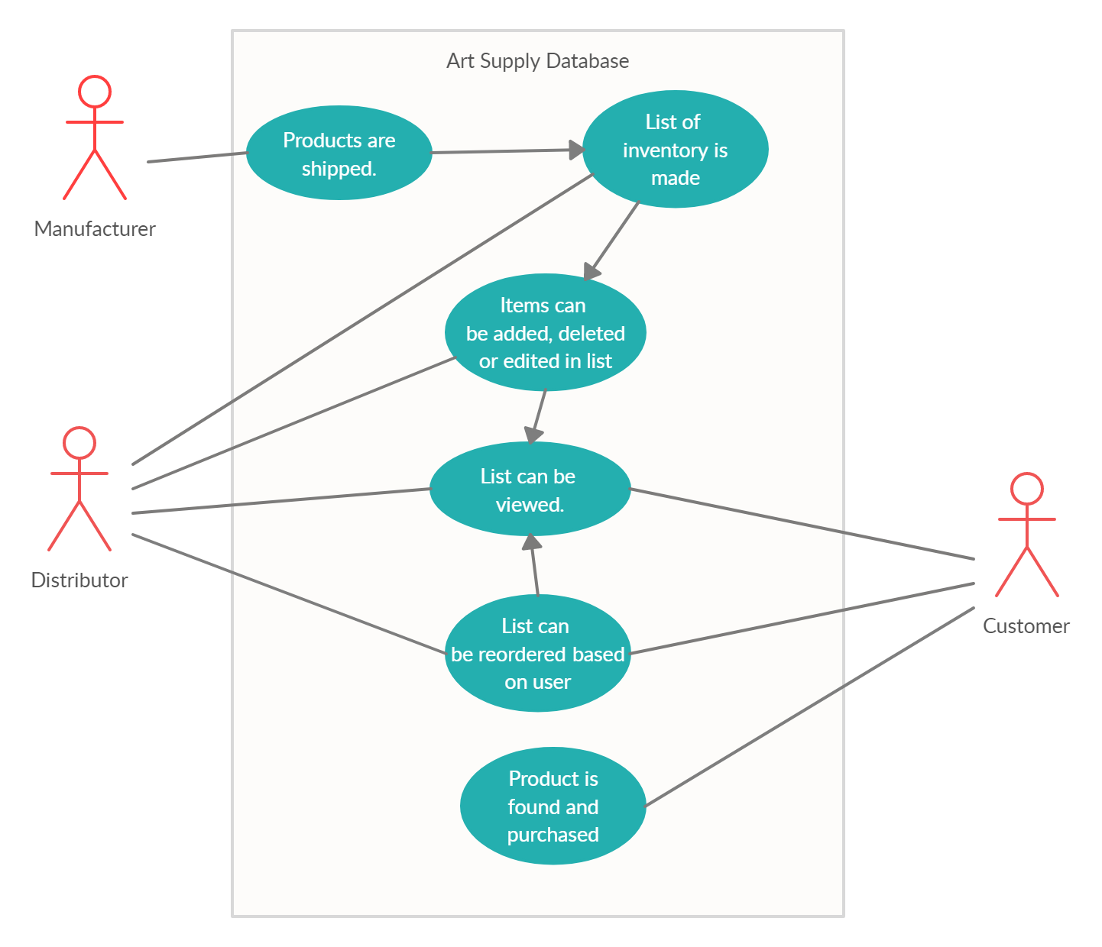
Use-case
Diagram

Slide 5
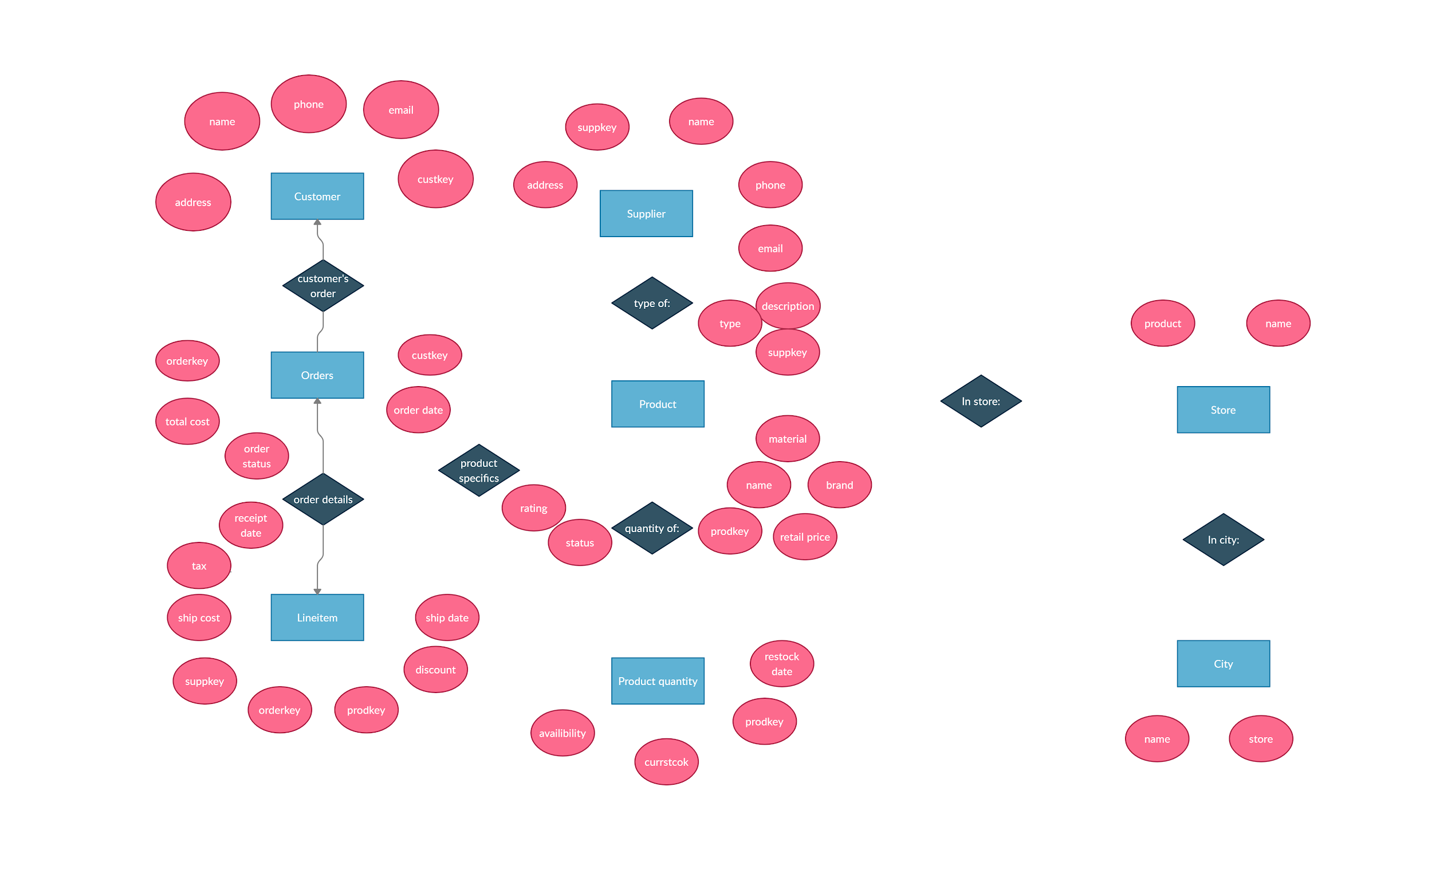
E/R Diagram
E/R Diagram

Slide 6
Relational Schema
Customer
c_name, c_custkey, c_phone, c_email, c_address
Orders
o_orderkey, o_custkey, o_totalcost, o_orderdate, o_orderstatus
Product
p_name, p_prodkey, p_type, p_material, p_brand, p_rating, p_status, p_retailprice, p_description
Prodquantity
pq_prodkey, pq_currstock, pq_restockdate, pq_availibility
Supplier
s_name, s_suppkey, s_prodkey, s_phone, s_email, s_address

Slide 7
Relational Schema
Lineitem
l_suppkey, l_orderkey, l_prodkey, l_discount, l_tax, l_shipcost, l_shipdate, l_receiptdate
Store
st_name, st_product
City
ct_name, ct_stores
In-city
storeName, cityName
In-store
storeName, productName, productBrand

Slide 8
Questions?

